Slide 1
Project 2: Improving Batch Normalization via Scaling and Shifting Relay
Shizhe Diao, Jincheng Yu, Duo Li, Yimin Zheng

Slide 2
Content
Introduction
Method
Evaluations
Summary
Notes:
From the poster, you can get a general sense of our proposed normalization technique. Due to the 10 mins time limit, this presentation will focus on parts missing from the poster, which are the detail of our method and experiment.

Slide 3
Introduction

Slide 4
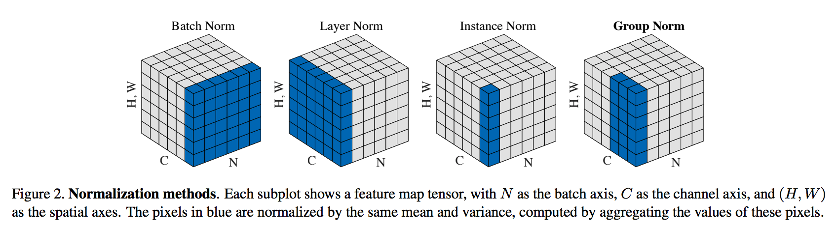

Normalization
Notes:
The normalization technique is an important component of latest Deep Neural Network. It can stabilize the intermediate feature distribution and shorten the training time.

Slide 5
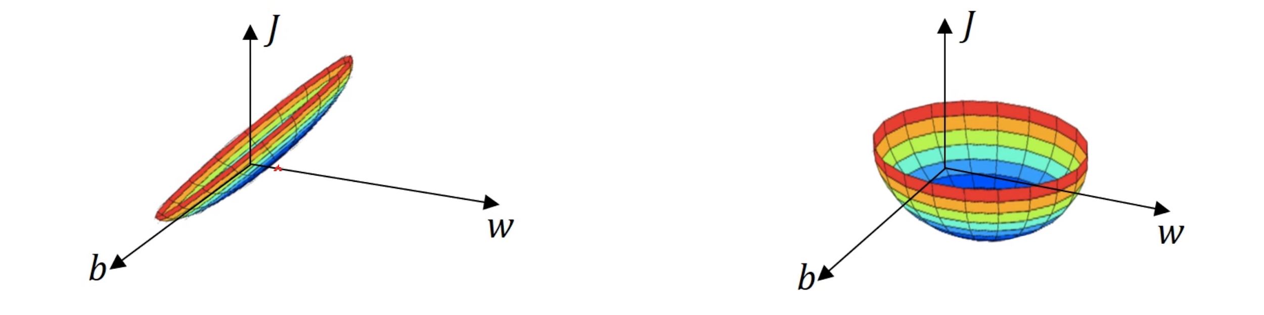
Normalization
2 stages:
standardization
affine transformation
standardization
Notes:
Common normalization techniques contain two stages, standardization and affine transformation.
The standardization stage modulates input feature distribution to one with zero mean and unit variance. The affine transformation stage retain the representation capacity lost in the standardization stage.
In this work, we proposed a general technique to improve the quality of parameters for the affine transform stage with a HyperNetwork, in which parameters are learned conditioned on the previously underused feature distribution across multiple layers of the same staged building block.

Slide 6
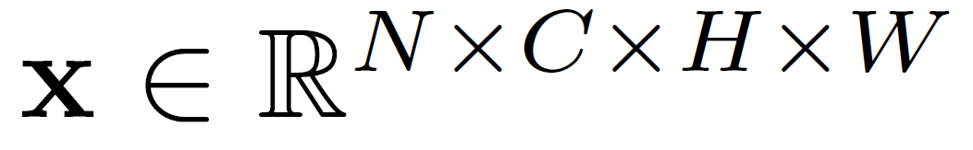
Normalization
2 stages:
Standardization
Affine Transformation
Standardization
standardize
Notes:
To better understand our technique, we first review common normalization process.
Consider the input feature map x of a generic normalization layer, which is in dimension N times C times H times W. Here N denotes batch size, C denotes number of channels, H and W denotes the height and width of a tensor.

Slide 7
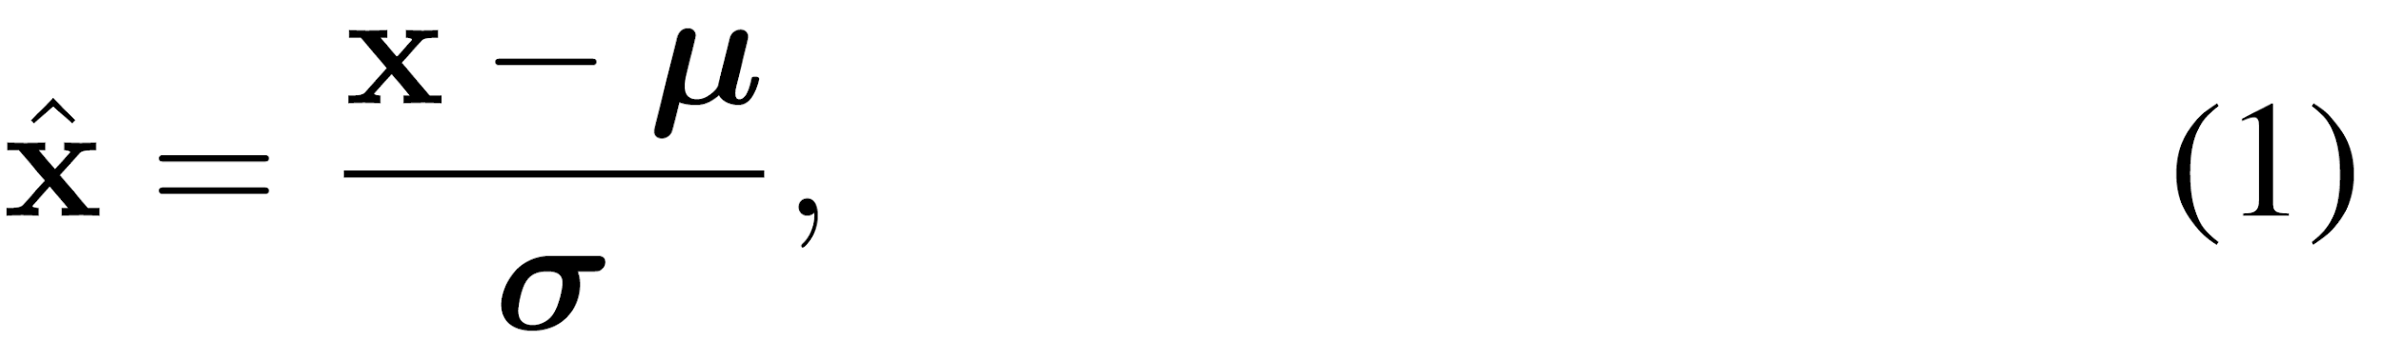
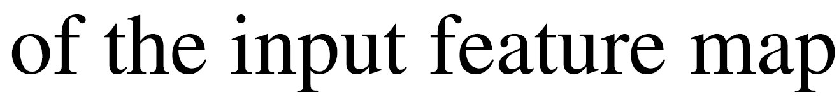
Normalization
2 stages:
Standardization
Affine Transformation
Standardization
standardize
Notes:
X first undergoes a standardization procedure shown in equation (1), where mu and sigma represent mean and standard deviation computed within K non-overlapping subsets. Take batch normalization as example, the K non-overlapping subsets are separated using channels.

Slide 8
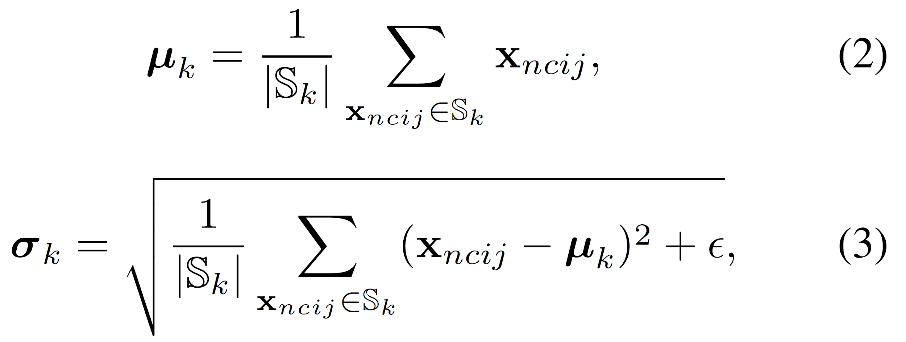
Normalization
2 stages:
Standardization
Affine Transformation
Standardization
standardize
Notes:
Next, let's denote each pixel in the feature map as xncij, then each element in mu and sigma could be computed using equation (2) and (3).

Slide 9
Normalization
2 stages:
Standardization
Affine Transformation
Standardization
standardize
Notes:
Here epsilon is an small positive constant to avoid numerical instability.

Slide 10
Normalization
2 stages:
Standardization
Affine Transformation
Standardization
standardize
Affine Transformation
Notes:
Then, the affine transformation is performed by applying equation (4). It re-scales and re-shifts the standardized feature map with trainable parameters gamma and beta respectively. Gamma and beta are learned separately for each channel but identical for each sample.
They are commonly updated using Stochastic Gradient Descent.

Slide 11
Method

Slide 12
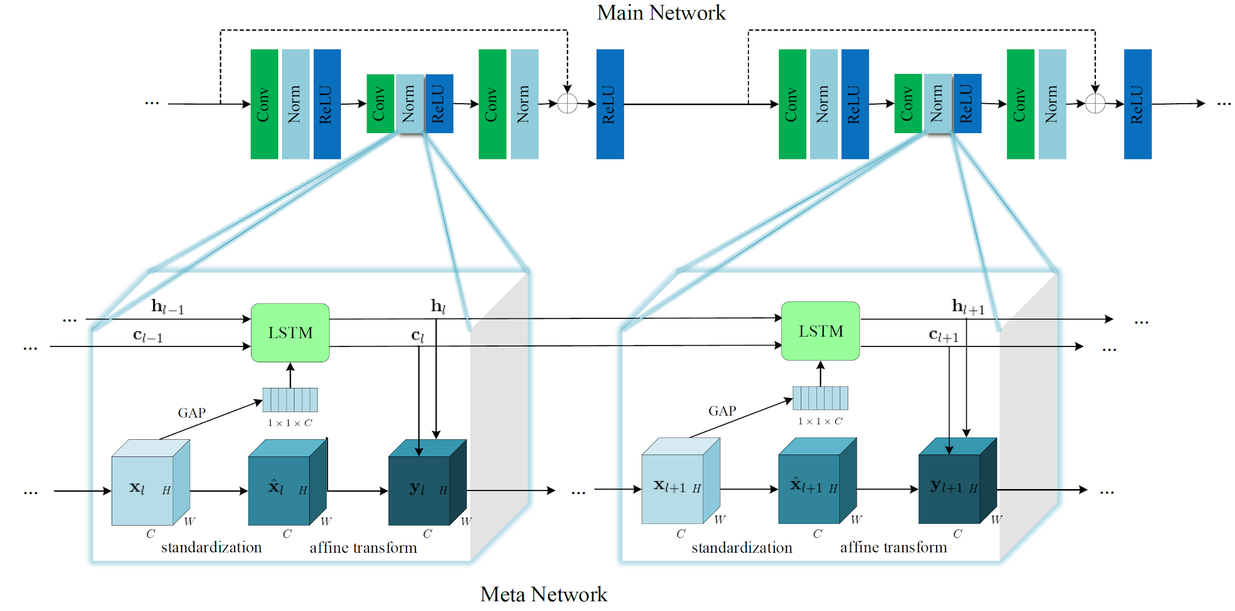
HyperNormalization
Notes:
Next, we introduce the detail of our proposed method, Hyper-normalization.
Let's look at the figure. In the l-th building block, we denotes xl as the input feature map of the normalization layer. We employ a shared LSTM model to aggregated and relay information across different building blocks in the same stage.
Notice that in this context, the LSTM is not unrolled along temporal axis as the common practice, but along the network depth.

Slide 13
HyperNormalization
Notes:
Thus, the hidden and cell state hl and cl could be derived as shown in equation (5), where GAP is the Global Average Pooling operation which gathers the contextual information for individual channels of a feature tensor and reduces the follow-up computational consumption.

Slide 14
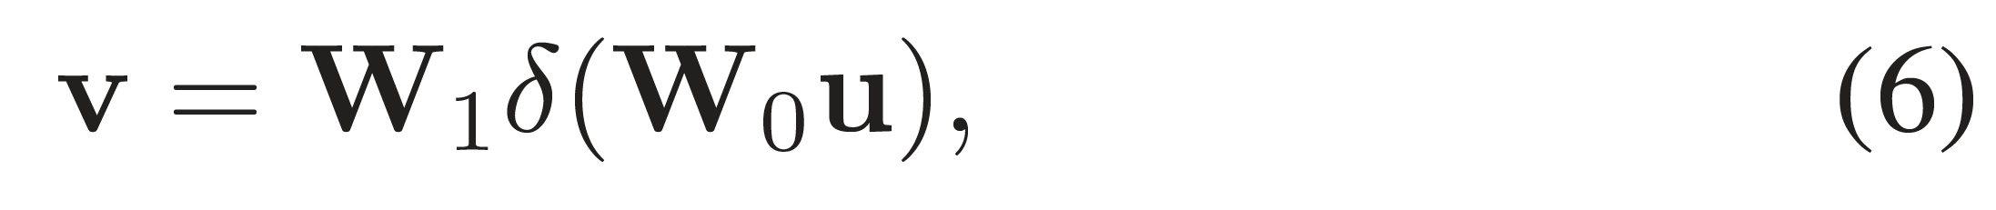
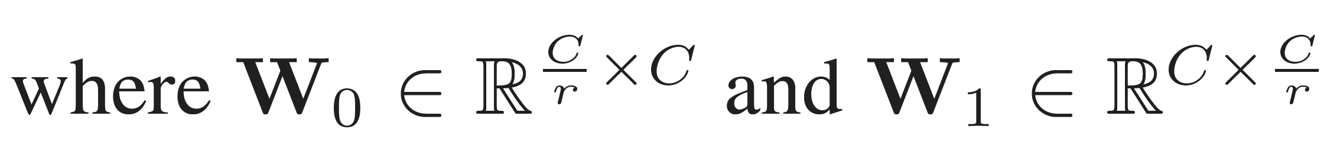
HyperNormalization
Notes:
We further make two specific modifications on the original LSTM to qualify it for the effective and efficiency of a meta network.
First, we adopt the bottleneck structure to process the input feature map and hidden state within LSTM, mimicking the wisdom of ResNet and SENet.
Its formula is shown in equation (6), where W0 and W1 are weight matrices of the FC layers, delta refers to the ReLU activation function, the input and output feature tensor u, v share the same number of channels.

Slide 15
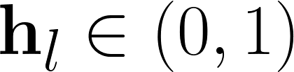
HyperNormalization
Notes:
Second, the hyperbolic tangent activation function for calculating the hidden state at a time stamp is replaced with the sigmoid function, which guarantees the range of hidden states to fall in range zero to one. This modification serves the purpose of pertinent precondition for gamma and beta.
Then, the current hidden and cell state could be extracted as the scale and shift parameter of a normalization layer, as shown in equation (7). Then, equation (4) can be reformulated as equation (8), where xl hat here is derived from xl following equation (1).

Slide 16
Evaluations
Notes:
We conduct comprehensive experiments to evaluate HyperNorm
on popular vision benchmarks, including image
classification, object detection and instance segmentation.

Slide 17
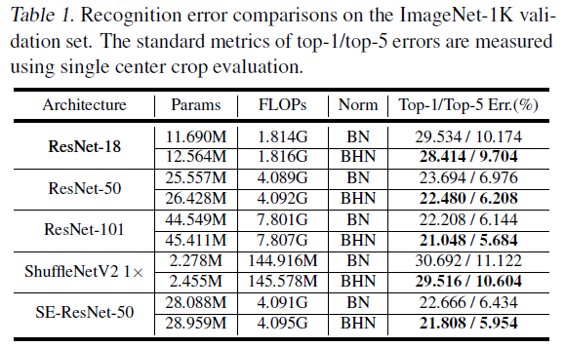
ILSVRC 2012 - Architecture
Notes:
We integrate our HyperNorm into several state-of-the-art CNN architectures, including ResNet, SE-ResNet and ShuffleNetV2
It is noteworthy that weight decay is deployed to all layers of (SE-)ResNet, with no exception of the trainable parameters and in the BN layers.
As is common practice, normalization parameters are initialized as gamma = 1 and beta= 0 in advance of training. Correspondingly, we also initialize the hidden and cell state of LSTM as zero vectors to mimic this behavior.
From table 1 we observe that ResNet and ShuffleNetV2 models equipped with HyperNorm consistently outperform the baseline counterparts with over 1% margin of top-1 error.
Notably, the increased computational budget is mostly around 0.1%. BHN leads to considerable gains via introducing negligible computational cost.

Slide 18
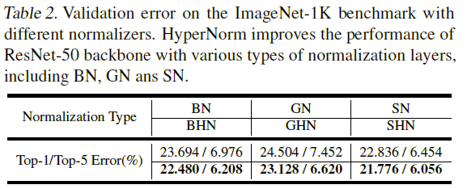
ILSVRC 2012 - NORMALIZER
Notes:
We also conduct experiments with Group Normalization which involves a group-wise channel-based standardization and Switchable Normalization
Table 2 compares the performance with respect to different normalizers which perform standardization on their corresponding sets of feature pixels.
The representation capacity of normalization layers is strengthened regardless of the standardization stage, improving the overall recognition accuracy by more than 1%.

Slide 19
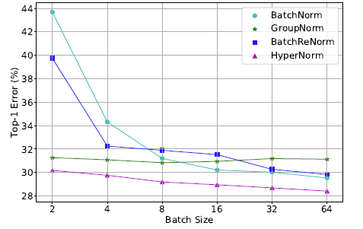
ILSVRC 2012 - BATCH SIZE
Notes:
We also compare the performance of BHN with BN, GN and BRN on ResNet-18. The mini-batch size exponentially decays from 64 to 2 per GPU.
As is often the case, performance of BN deteriorates noticeably along with the decrease of batch size. BRN ameliorates such degradation for BN under the micro-batch scenarios, but the accuracy still cannot parallel that of the large-batch setting. GN seeks a trade-off between microbatch and large-batch scenarios, which achieves acceptable performance for small batch size without sacrificing much accuracy for large batch size.
Batch HyperNorm could adapt to various settings of batch size, retaining a decent performance under all evaluation settings. BHN beats the other normalization methods
with a large margin regarding arbitrary batch sizes, thanks to the adaptive affine transformation which strikes a better balance between the input sample and population statistics.

Slide 20
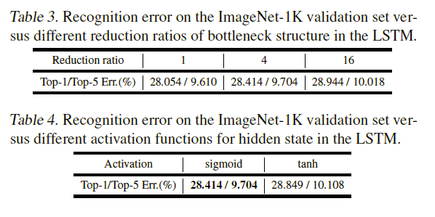
ILSVRC 2012 - ABLATION STUDY
Notes:
We perform ablation studies on the meta network architecture, utilizing ResNet-18 on ImageNet as the test case.
First, we change the positions where HyperNorm is integrated into the building blocks. We find out that first normalization layer in a basic block is a better choice.
Next, alter the reduction ratio of the bottleneck structure and the activation function for hidden state in the LSTM model as in Table3.
Finally, we replace the modified LSTM with the original one as in Table4.

Slide 21
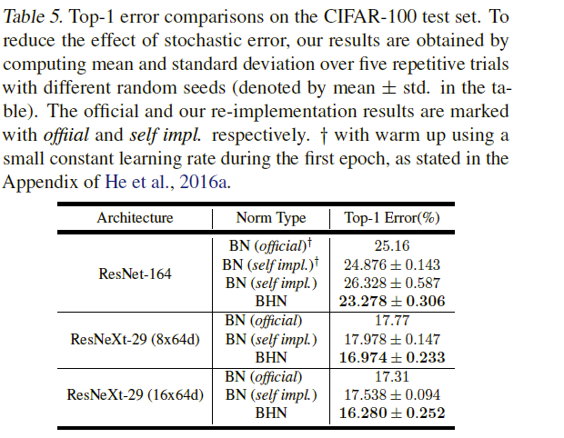
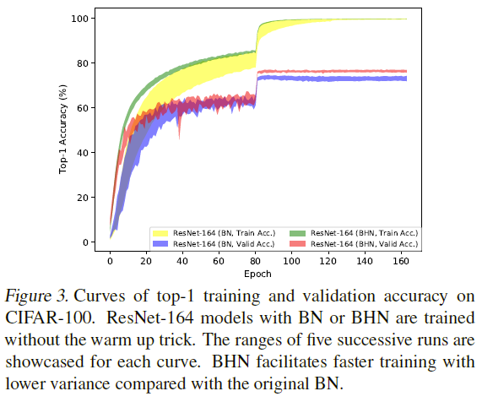
CIFAR-100
Notes:
CIFAR-100 is another popular image recognition benchmark beyond ImageNet. The performance of ResNet-164 with BN shwon in Table 5 has a significant reliance on this technique for optimization. Under the same circumstance without warm up, ResNet-164 with BHN outperforms its baseline counterpart by a margin of over 3%.
Viewed from the training curves in Figure 3, BHN guarantees more stable optimization and faster convergence.
When integrated into the high-performing ResNeXt-29 models, BHN still consistently yields reduction of the top-1 error rates by more than 1% over vanilla BN.

Slide 22
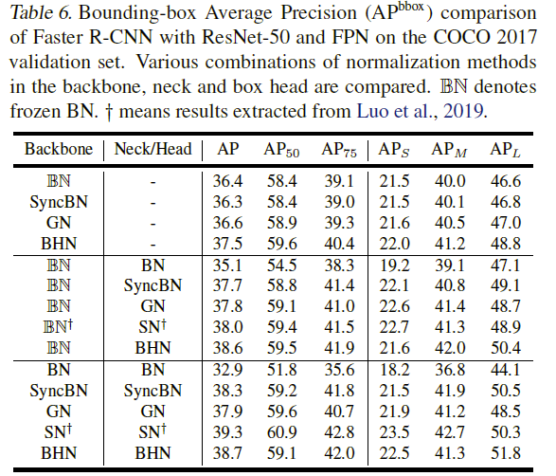
MS-COCO 2017
Notes:
Aside from image recognition, we also evaluate HyperNorm on object detection and instance segmentation tracks of the Microsoft COCO (Lin et al., 2014) benchmark via transfer learning.
Our BHN achieves comparable Average Precision with other advanced normalization methods and shows a considerable promotion over the vanilla BN.

Slide 23
Summary

Slide 24
Conclusion
In this project, we propose a novel normalization method named HyperNorm, which employs shared meta LSTMs to generate normalization parameters in a self-adaptive fashion. The meta network makes a choice about how the standardized representation is transformed subsequently in a single forward pass. It reconfigures the routing of features across hierarchical normalization layers, enhancing the feature representation ability. It could also rectify the estimated statistics with the sample-aware mechanism, potentially dissolving the inherent deficiency of micro-batch training.

